Slide 1
Basic Of Shell Scripting II

Slide 2
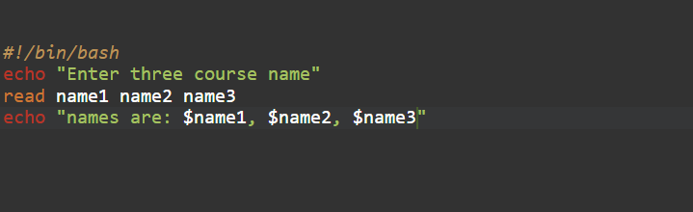
read Command
Syntax for taking multiple user input using read keyword.

Slide 3
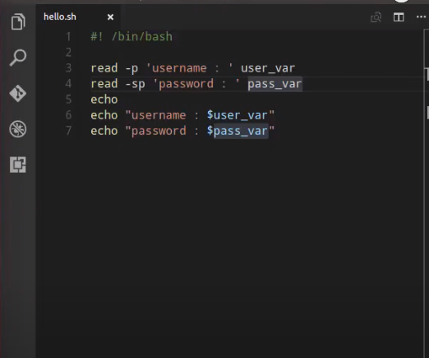
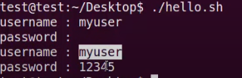
Example

Slide 4
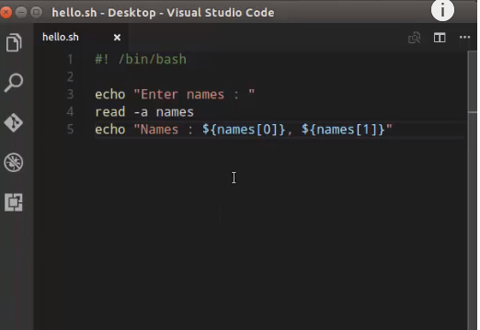
Example

Slide 5
Adding Basic Options
Let’s take a look at some of the most basic options we can use:
-a array: stores the results of the word split operation in an array rather than separate variables
-s: does not echo the input line to the standard output stream
–p prompt: print the prompt text before requesting the input from the standard input stream without a <newline> character
-t timeout: attempt to read the input for a given period of seconds
–N: read exactly N characters from the input unless a timeout occurs or EOF is reached

Slide 6
Conditional Statement
If-else Statement #
Bash if conditionals can have different forms. The most basic if statement takes the following form:
if TEST-COMMAND
then
STATEMENTS
Else
STATEMENTS
fi
The if statement starts with the if keyword followed by the conditional expression and the then keyword. The statement ends with the fi keyword.

Slide 7
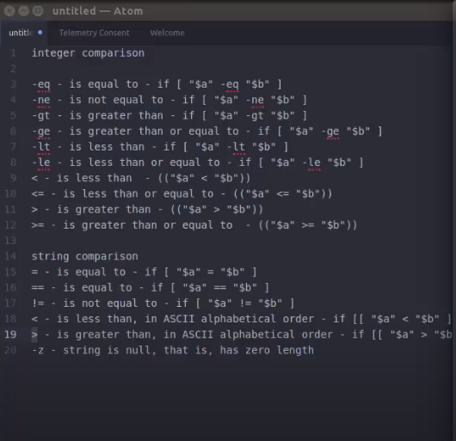
Syntax

Slide 8
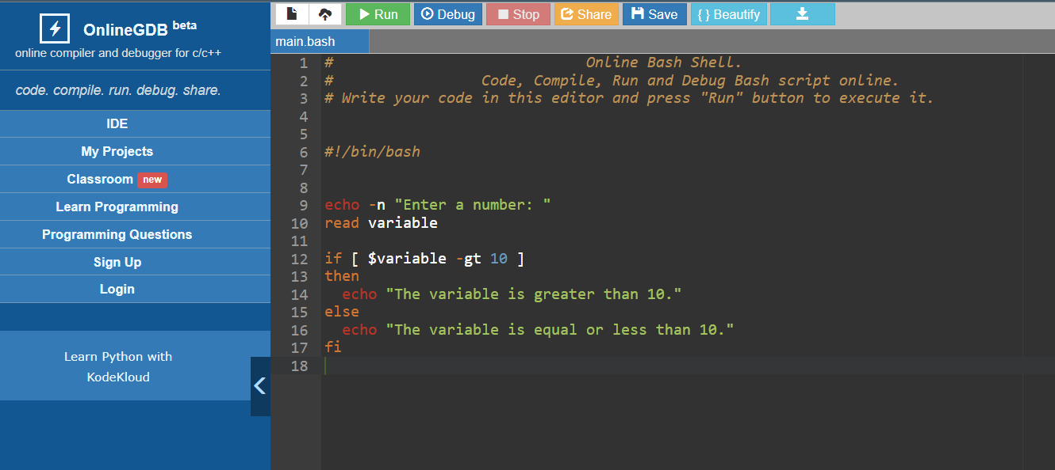
Example Code

Slide 9
if..elif..else Statement
if TEST-COMMAND1
then
STATEMENTS1
elif TEST-COMMAND2
then
STATEMENTS2
else
STATEMENTS3
fi
If the TEST-COMMAND1 evaluates to True, the STATEMENTS1 will be executed. If the TEST-COMMAND2 evaluates to True, the STATEMENTS2 will be executed. If none of the test commands evaluate to True, the STATEMENTS2 is executed.

Slide 10
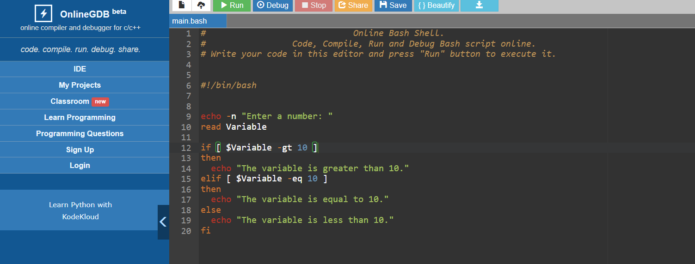
Example Code

